Slide 1
LED Display
Tom, Rishabh, Dawei, Ava, Si Yuan
RAL Visitor Centre
07.07.23

Slide 2
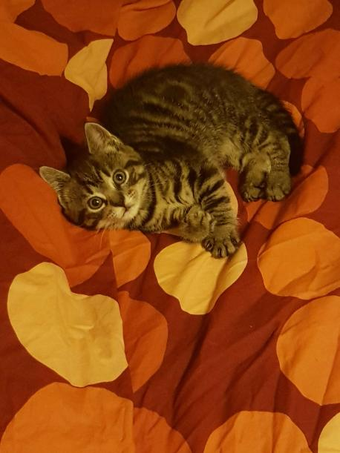
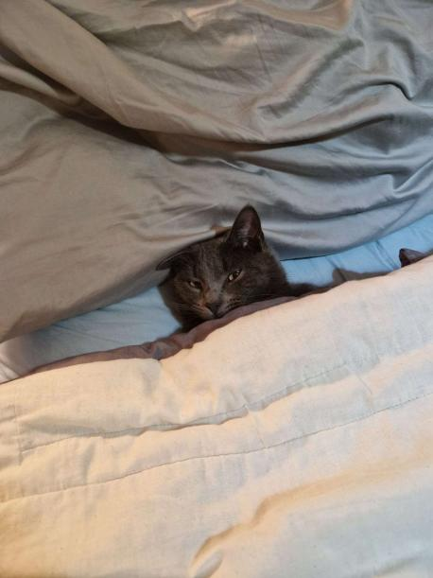
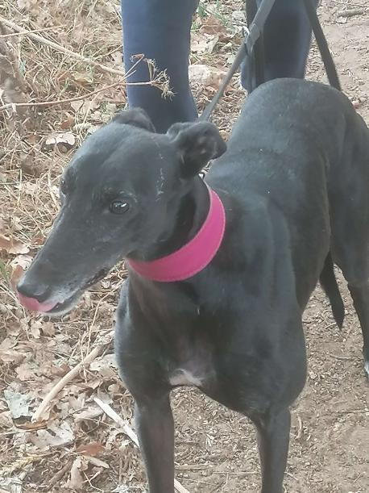
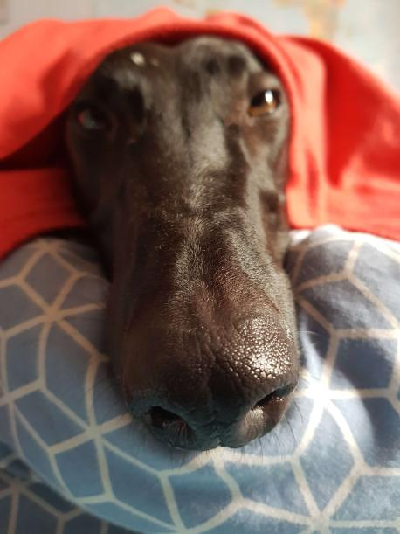
Personal Introduction & How Has This Work Experience Benefited You?
Tom Sutton:
Pets (Felina, Fernando, Joey and Baz from top left to bottom right)
Hobbies - I enjoy designing and playing games (both board and video), going to the gym, woodworking and Dungeons and Dragons.
Work Experience - Insight into the STEM life and community, still hard-set on becoming a software engineer.

Slide 3
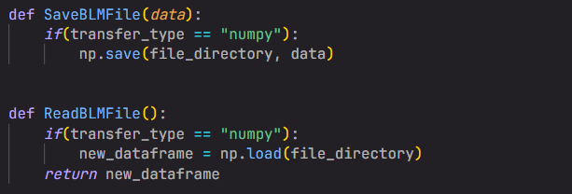
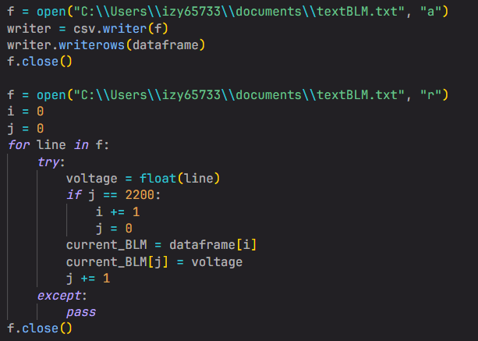
Stage 1 Projects: Group 1E: Data Handling
Aims - Finding an efficient way to store and read files, optimising transfer speeds.
Research - Different file types, different data structures, different transferring methods.
Testing - Testing speeds of transfer rates.
Results - We found that saving to numpy files lead to the fastest transfer rates

Slide 4
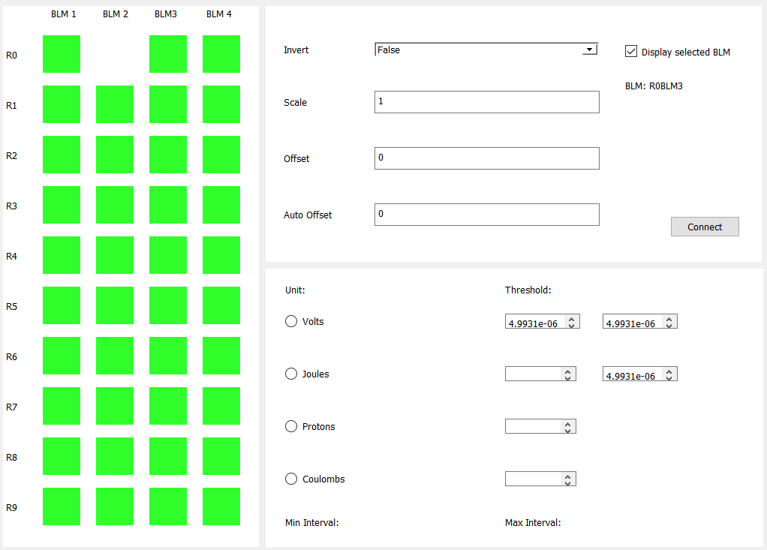
Stage 2 Projects: LED
Aims - An easy to visualise array of LEDs that display if the sum of data is less than a given threshold
Design - Design with PyQt5 designer, later with python code
Result - GUI that technically works as intended but crashes.

Slide 5
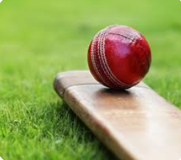
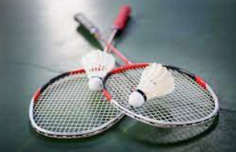
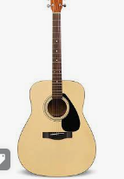
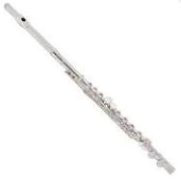
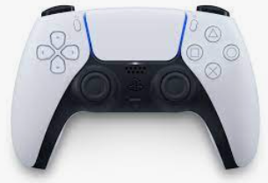
Personal Intro and Work Ex Benefits
Hobbies
Sports
Gaming
Music
Benefits
Improved my Teamwork and Communication
Helped me understand more about what I want to do in
the future

Slide 6
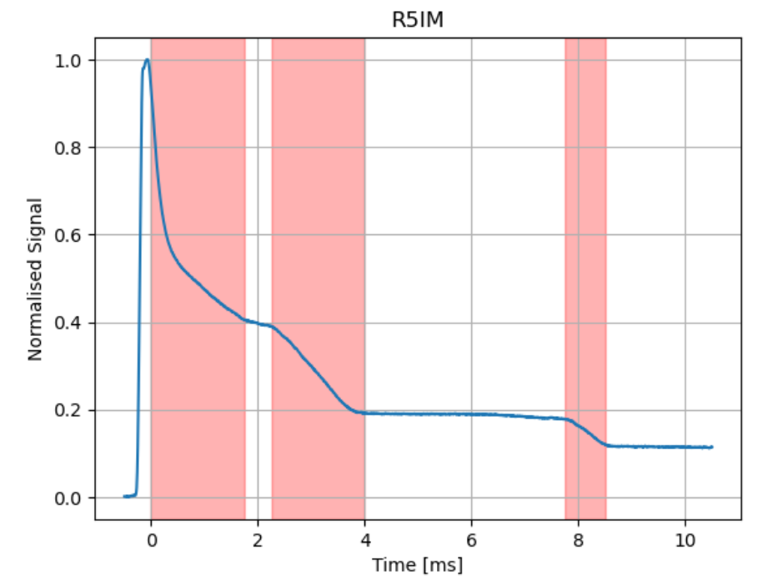
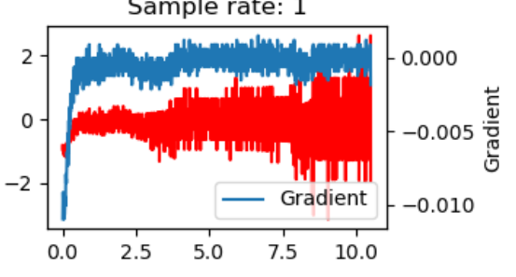
Stage 1 Project: Loss Finders
My Tasks
Documentation of code
Testing
What I learnt
Much harder than I previously thought
Importance of teamwork

Slide 7
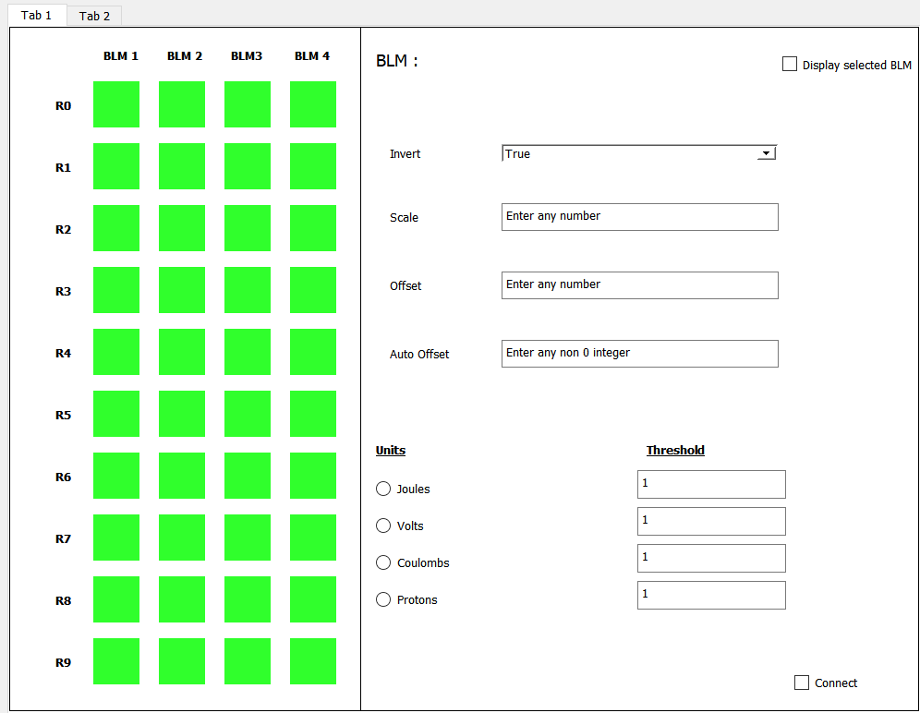
Stage 2 Project: LED Display
My Tasks
Designing the GUI
Creating the GUI
Implementing the GUI into python
What I learnt
Importance of non-coding based tasks

Slide 8
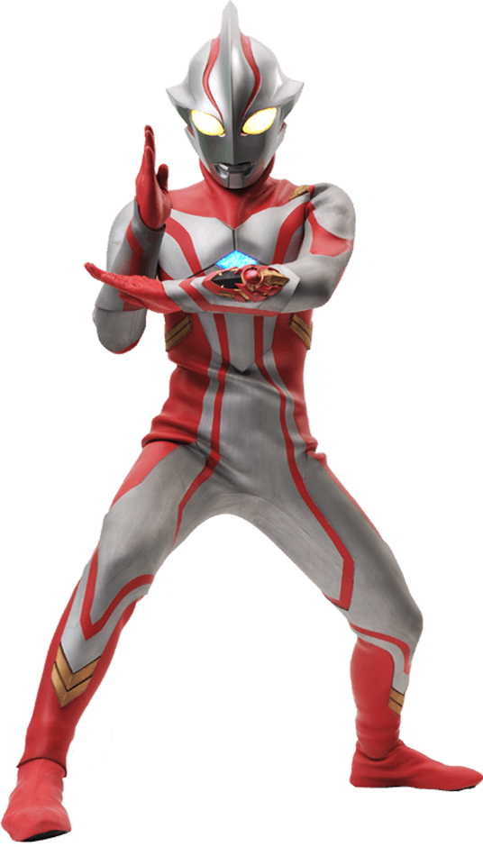
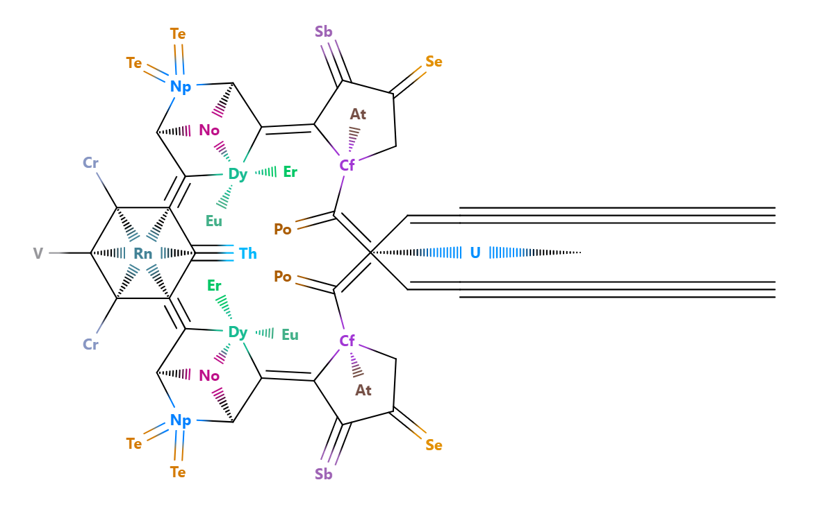



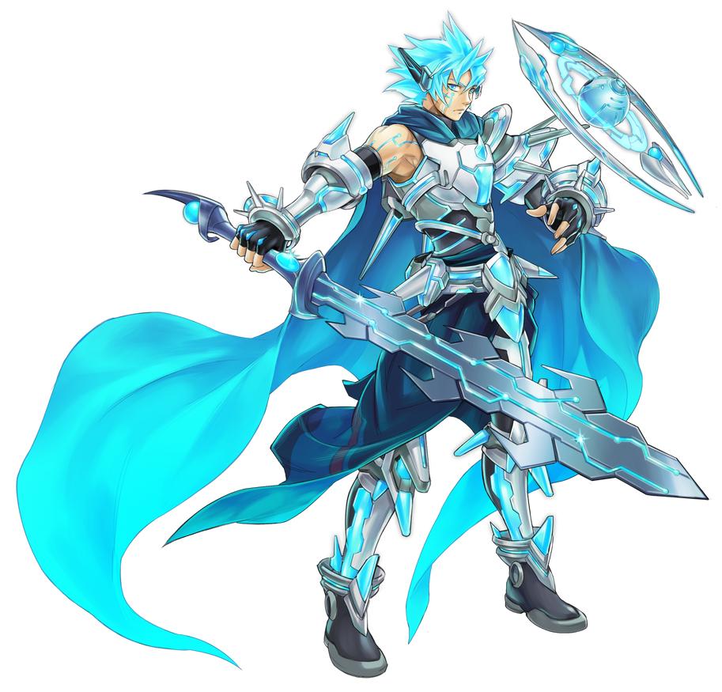

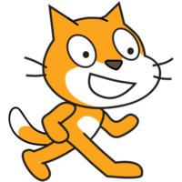

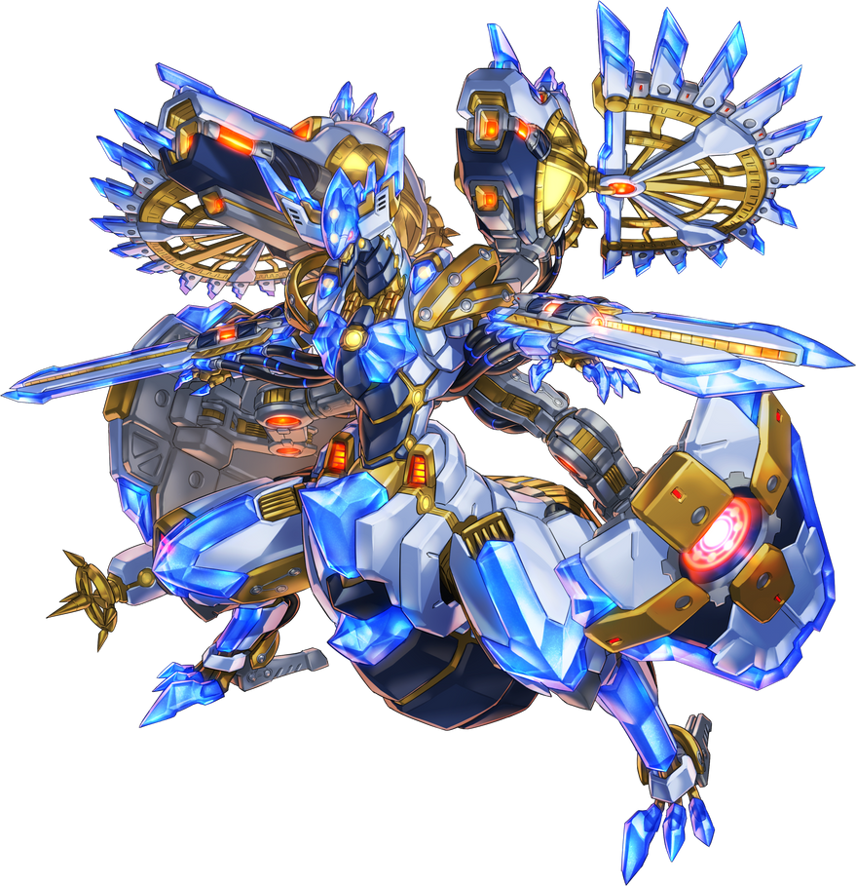


Sup, I’m Dawei to go
Programming
Organic Chemistry
Geometry
Graphic Design
Music Composition
Linguistics
Yu-Gi-Oh!
Creative Writing
I’m a nerdier nerd
I have too many interests
I love creating and naming things
I browse Wikipedia in my free time
I overthink stuff
I type fast
Also, I live really far away
I call this a Beta Uranium Railgun.
create struct 'accelerator' {
evolve self.create(ctx) [
| 'topEnergy' [int] = 700
| 'product' [pool[protons, neutrons]] = slot:neutrons
] {
self.autoset()
}
}

Slide 9
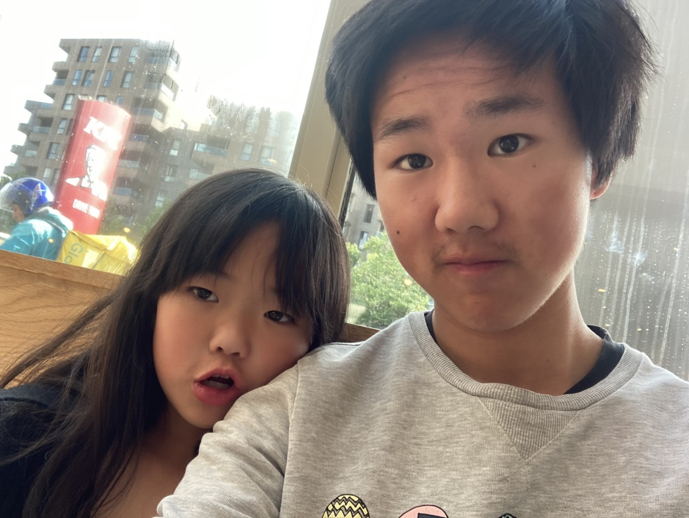
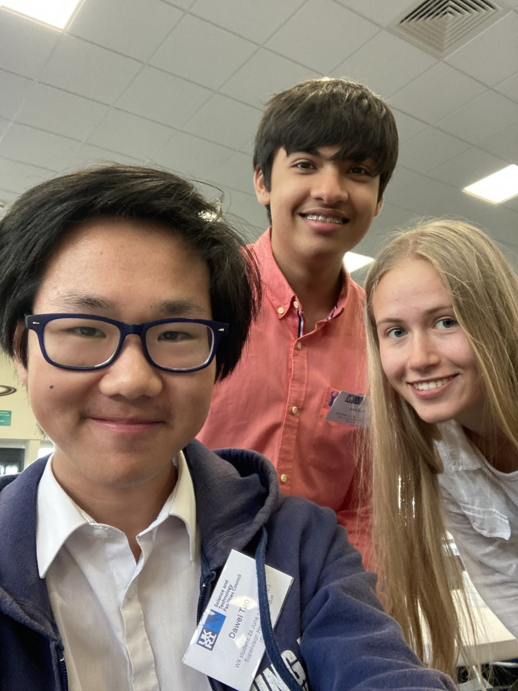
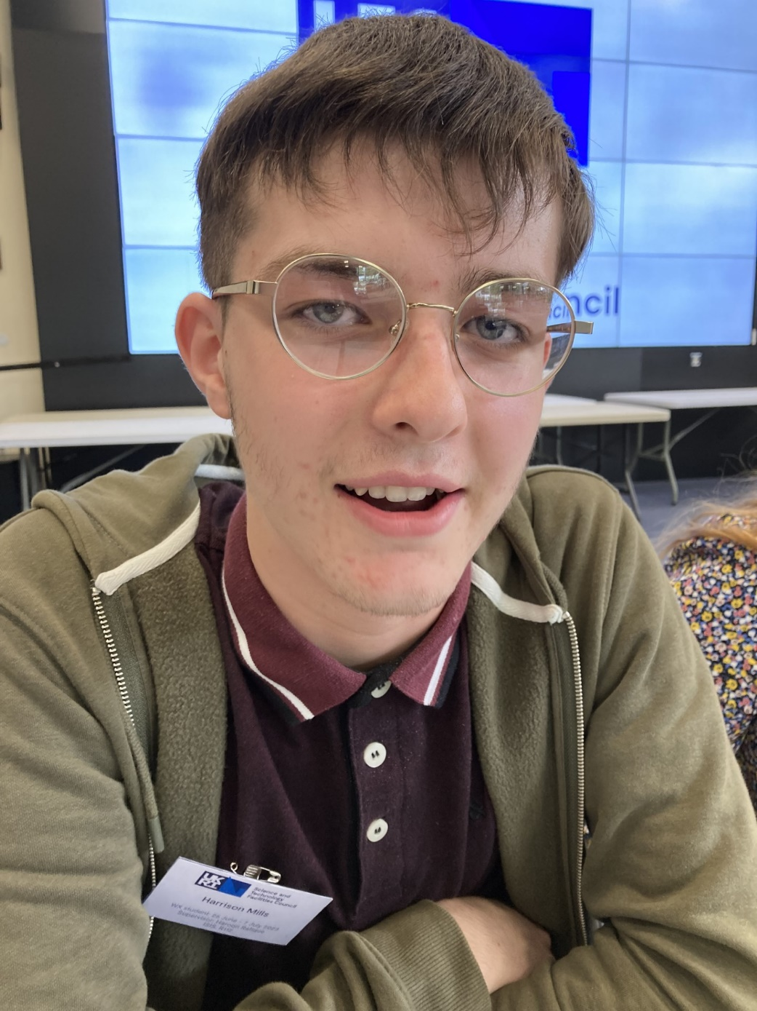
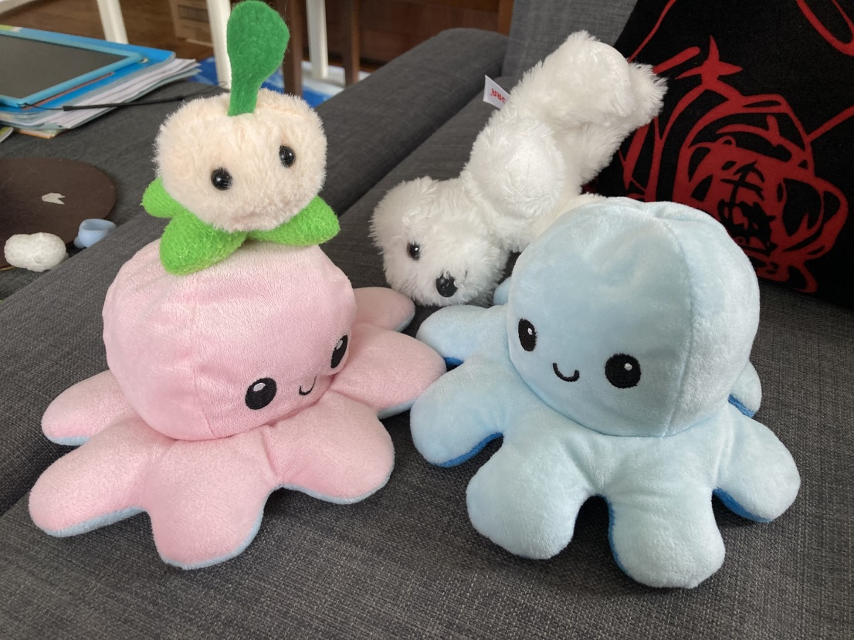
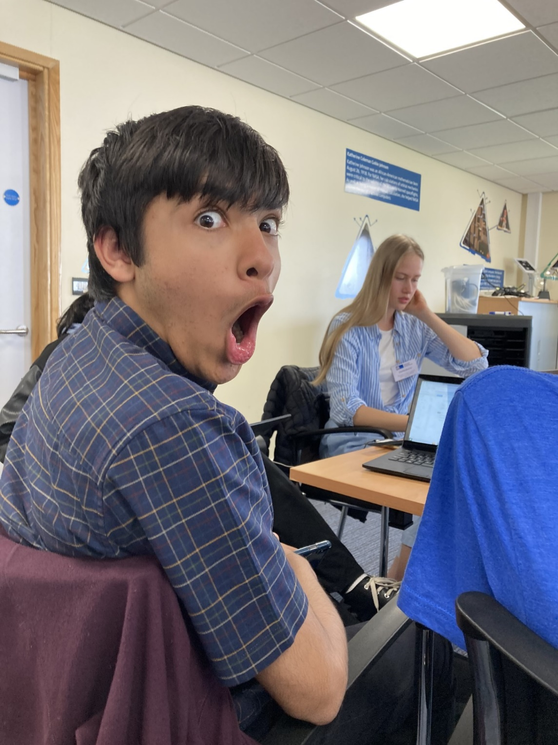

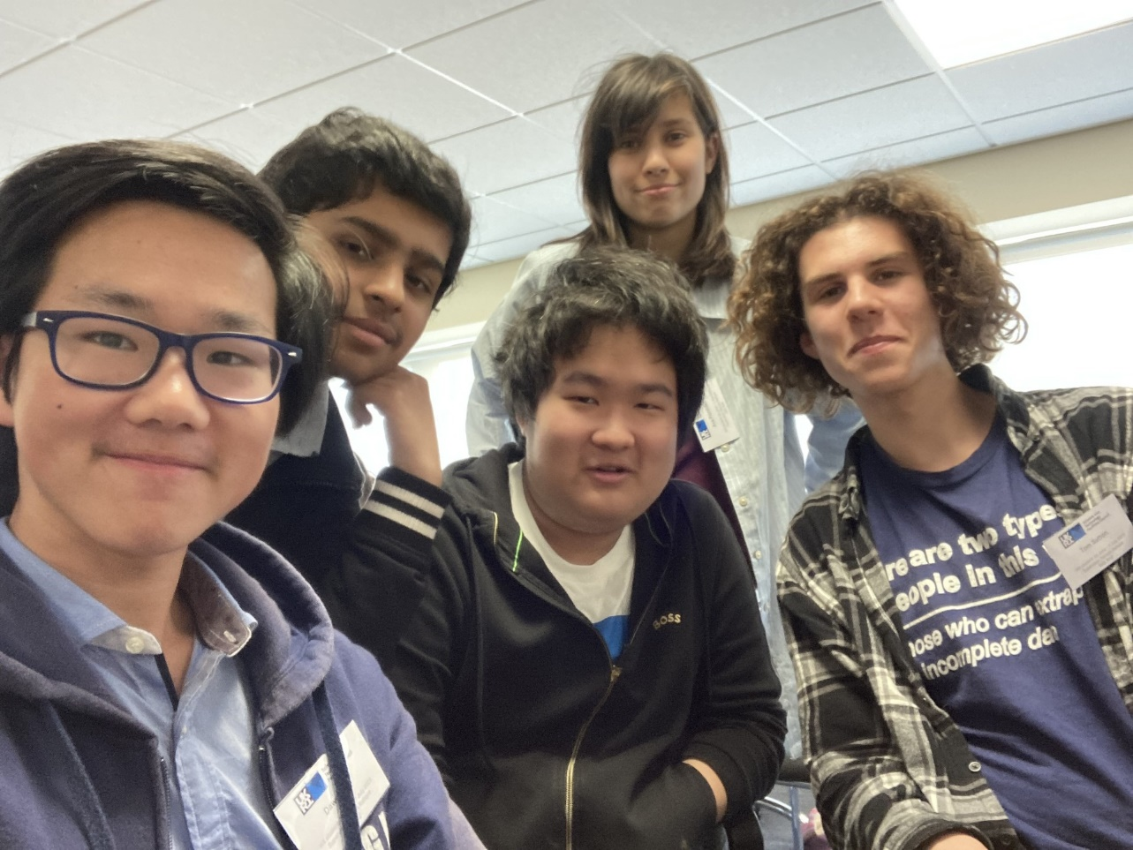

Slide 10
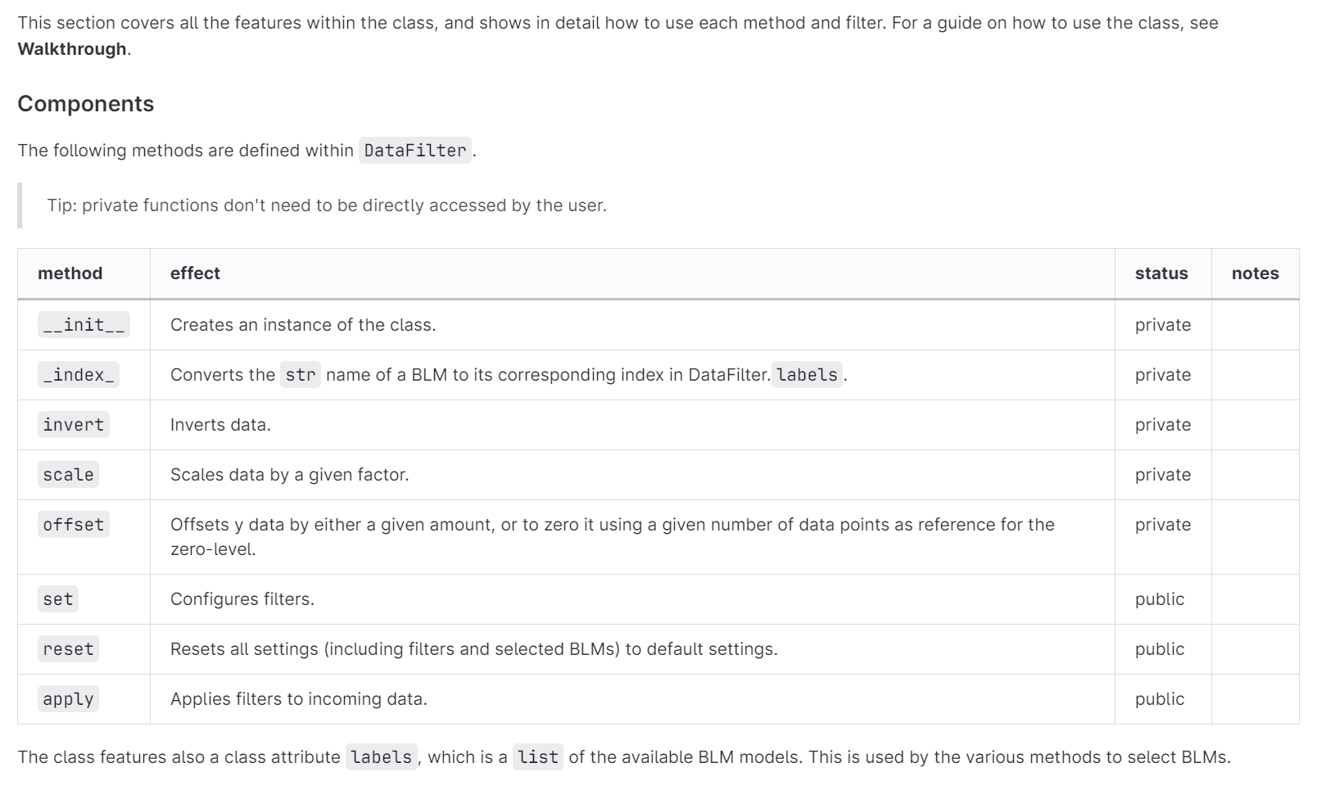
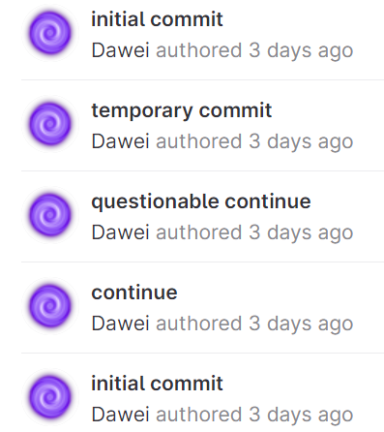
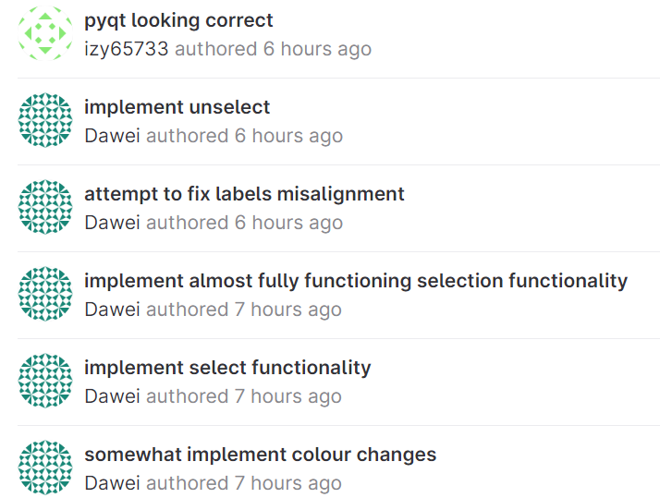
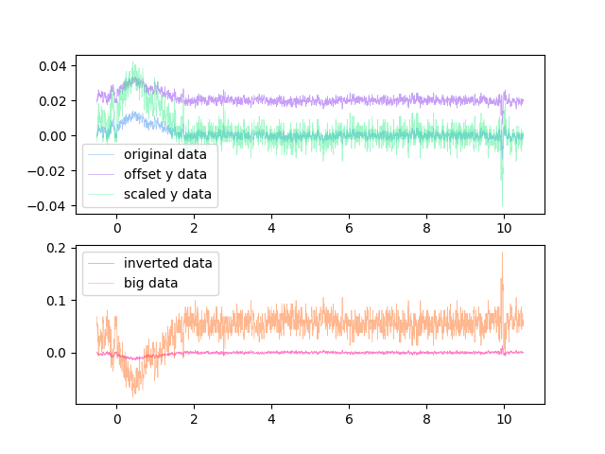
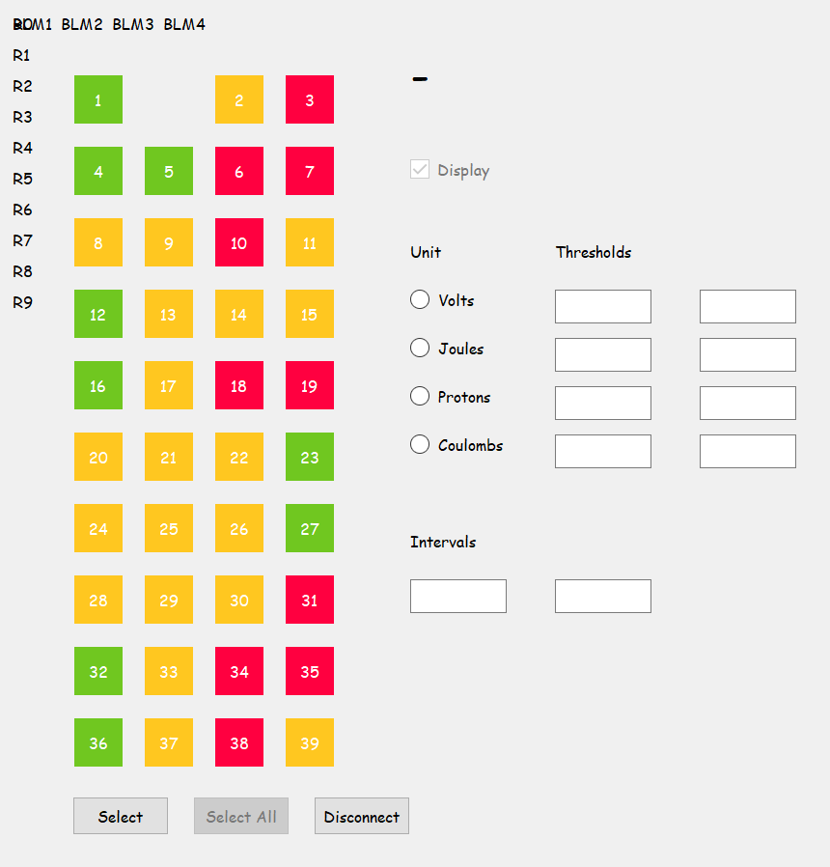
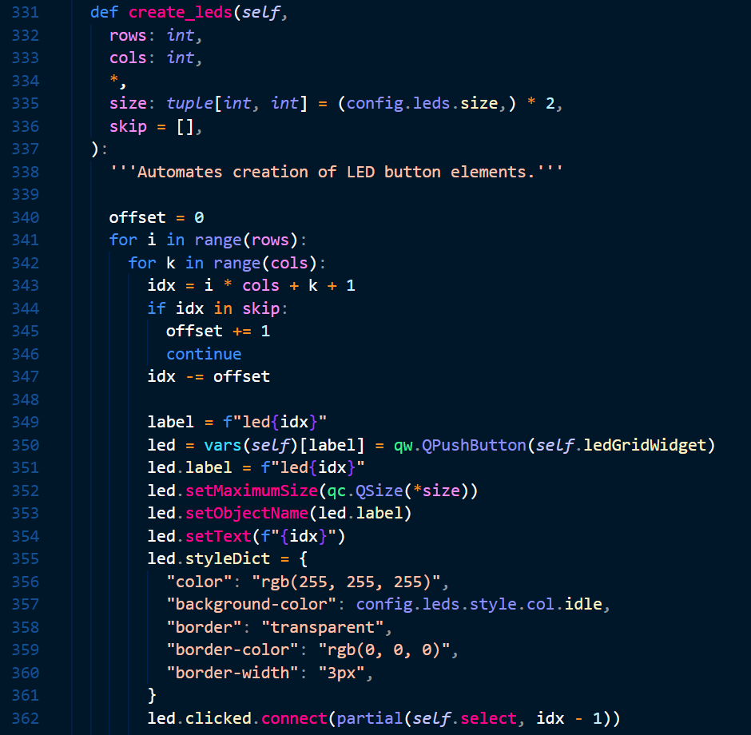
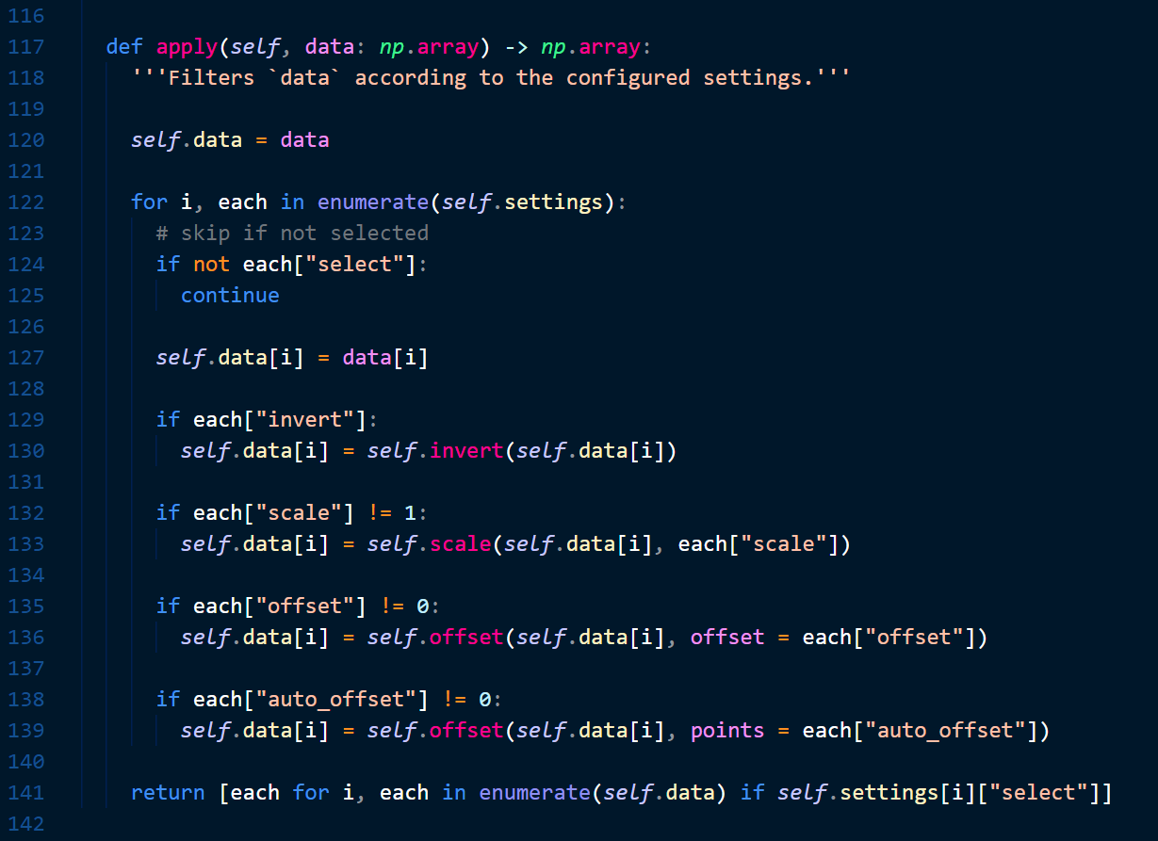
Stage 1 – Data Filtering
Stage 2 – LED Display
Ansh, Charlize
Notes:
tied work together in a class,
documentation
collaboration is hard, both as difficult and harder than I expected
never gonna give this up

Slide 11
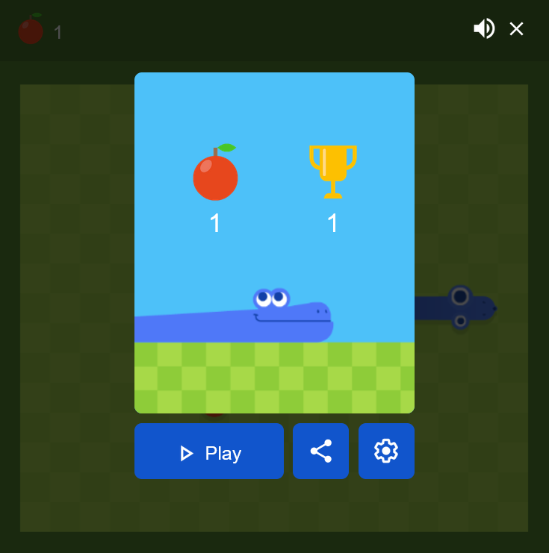
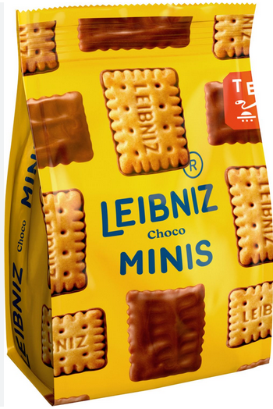
Ava
Hobbies:
Profesional Snake player
Programming
Football
WX Benefits:
Learnt git
Learnt more python
Improved teamwork
Have a clearer idea of future
More physics.

Slide 12
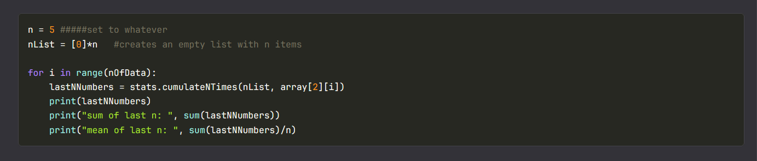
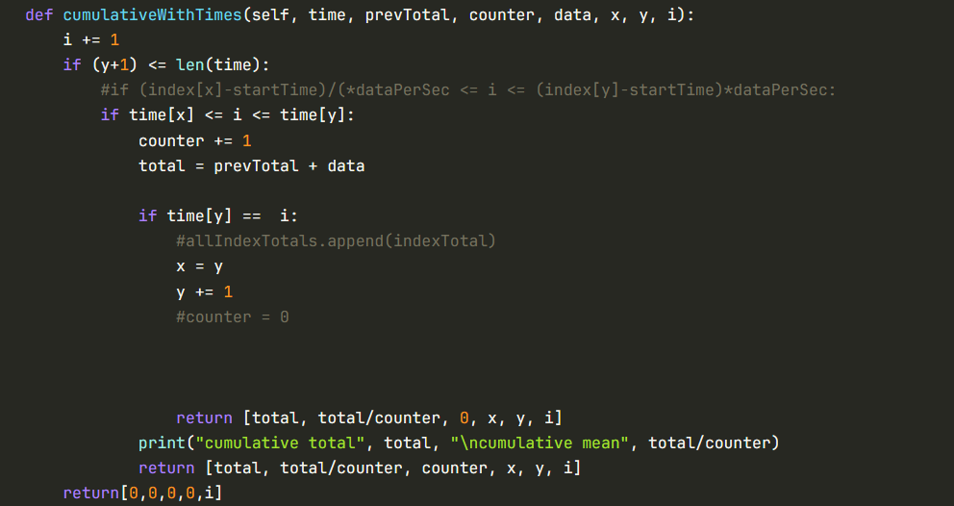
Stage 1 Projects: Group 1B: Statistics

Slide 13
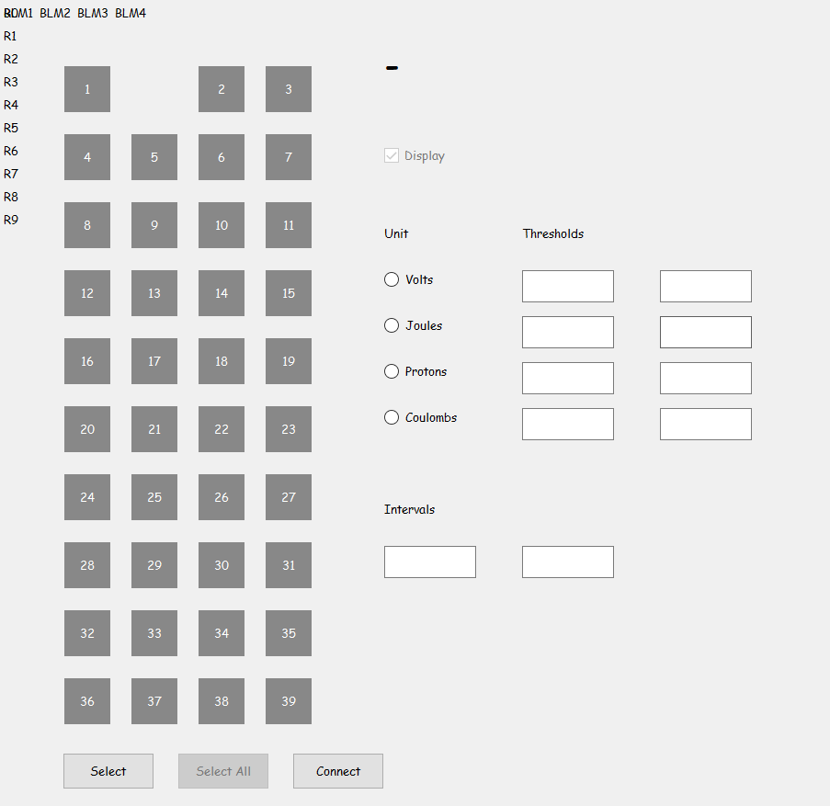
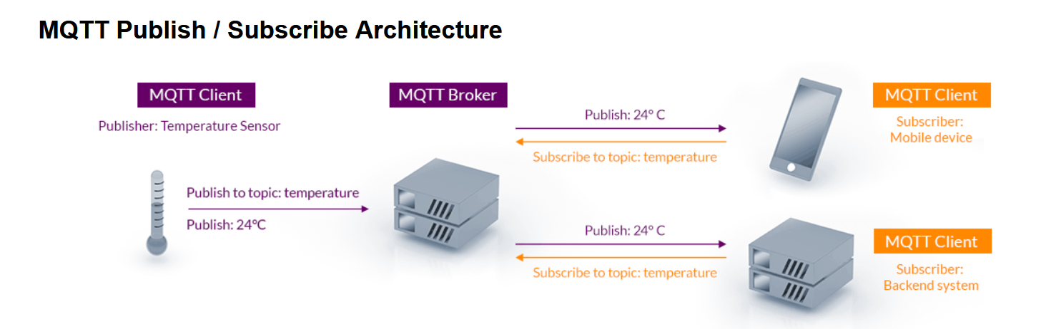
Stage 2 Projects: LED Display GUI
Changes time intervals to momentum and KE for use with energy ramp functions
Allows use of percentage intervals, calculates proportion of data that is being viewed
Made GUI work with MQTT

Slide 14
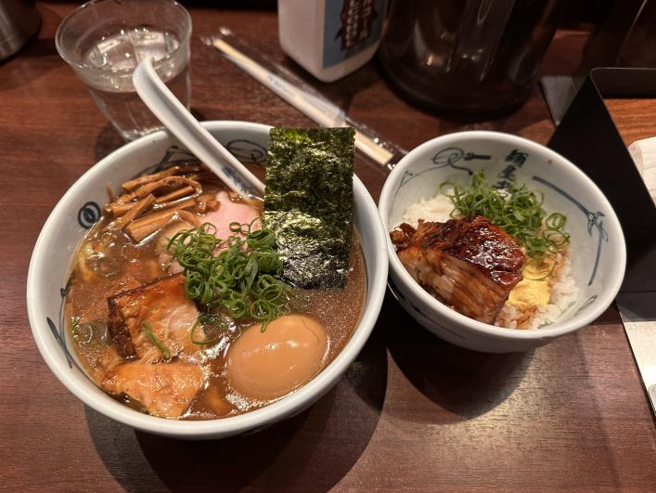
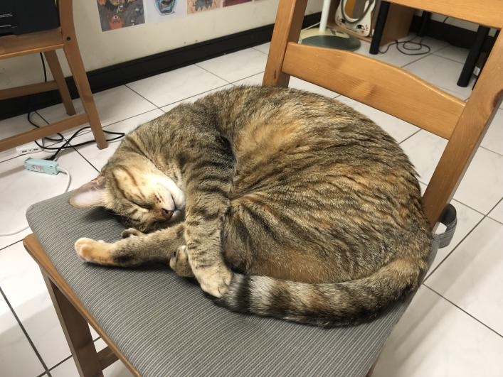
Personal Introduction & How Has This Work Experience Benefited You?
Name: Si-Yuan Huang
Hobbies: Cats, Ramen
How has this experience benefited you?

Slide 15
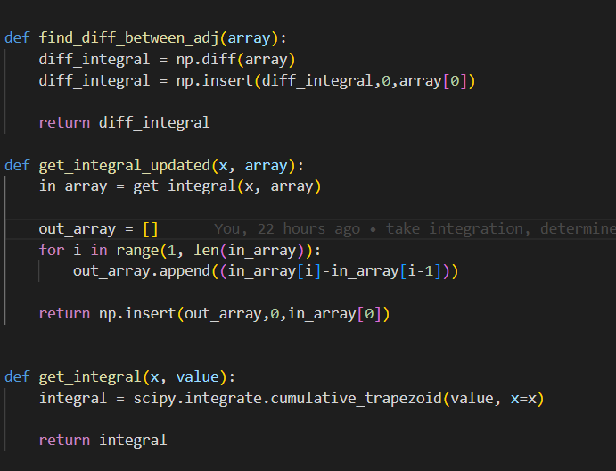
Stage 1 Projects: Group 1G: Integrating
Investigate integration method
Convert raw data in volt to number of proton
Bulk integration

Slide 16
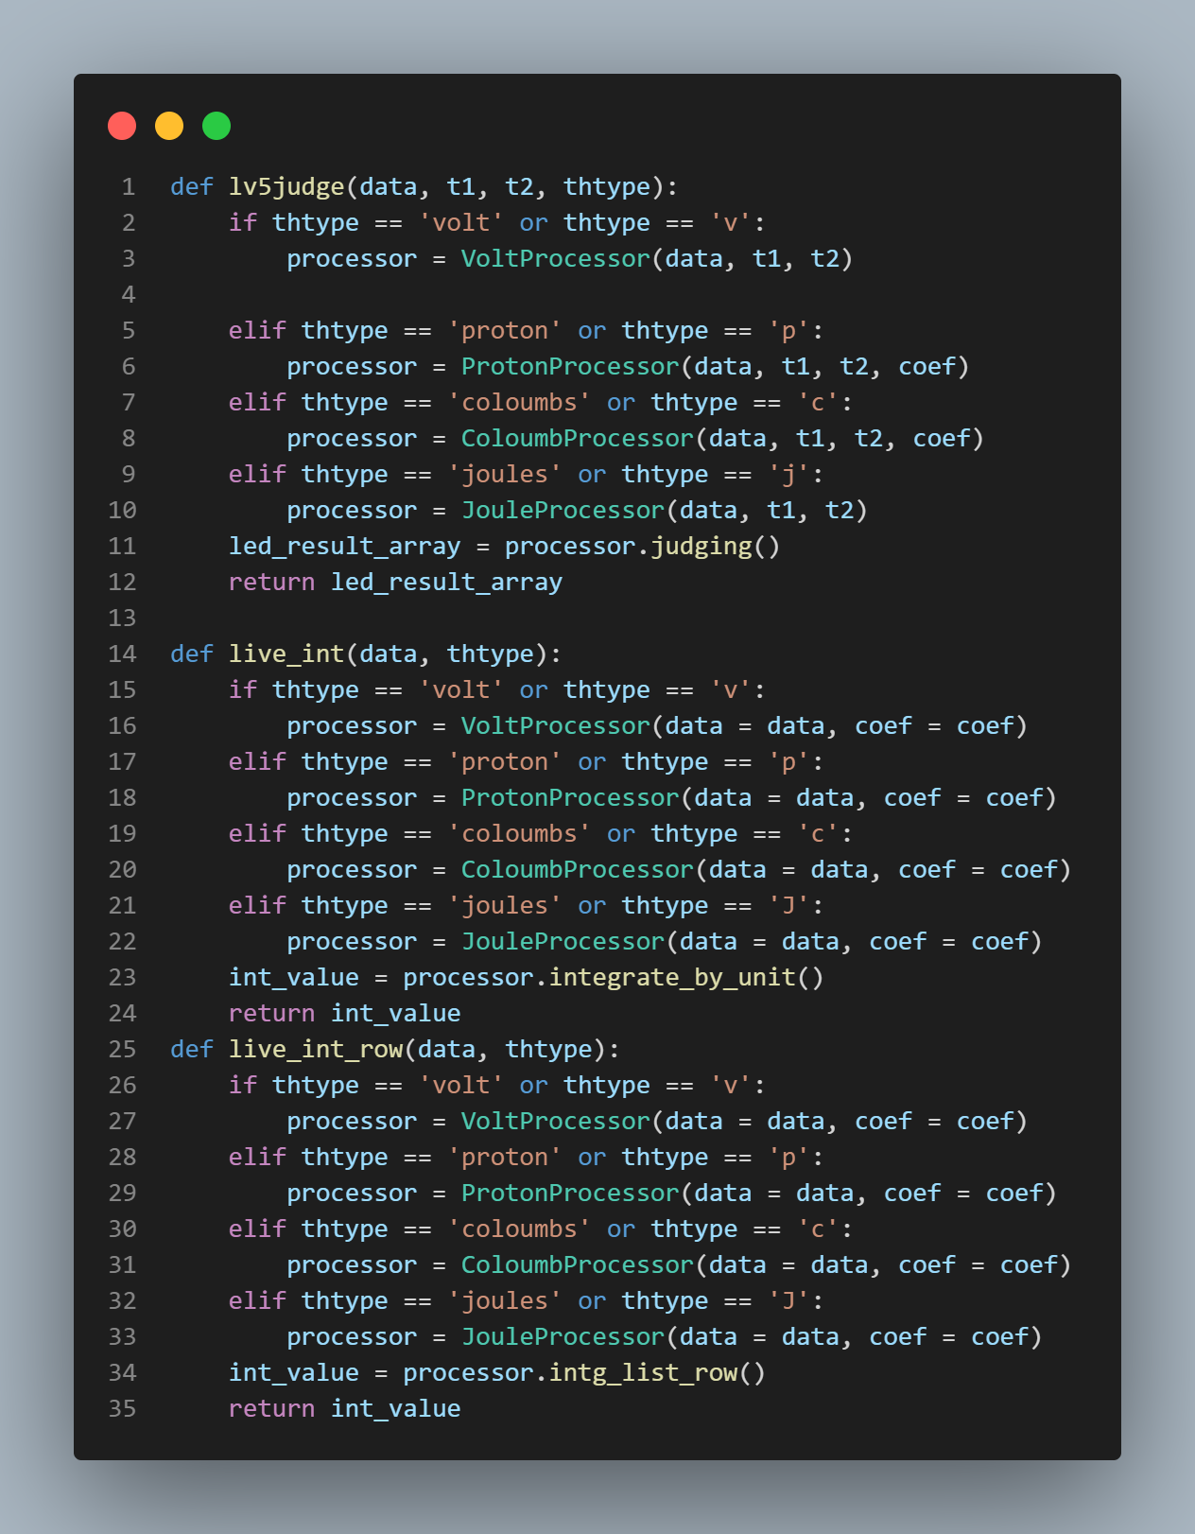
Stage 2 Projects: Waterfall GUI
Backend
Convert units volt/proton/coloumbs/joules
Integrate data by their units
Determine the bean loss data.

Slide 17
Acknowledgements
Esher
Haroon
Bill
ISIS
Public Engagement team

Slide 18
GUI Demo

